Slide 1
CHAPTER 2 Generalised Predictive Control 7 The T-filter in GPC
Anthony Rossiter

Slide 2
Introduction
The previous video observed that a simplistic implementation of GPC could be highly sensitive to measurement noise.
Consequently there is a need to consider why this might be and how one could improve the scenario?
Viewers will be unsurprised to hear that the most obvious thing to try is a low-pass filter which in essence filters out (ignores) high frequencies.
So, this is what early researchers did in GPC. It was found to be effective and thus there was little need to go beyond this for most cases.

Slide 3
Sensitivity to noise
Find the transference from noise to input (or output). Use forward path over (1+return path).

Slide 4
Improving sensitivity
Sensitivity is linked to the compensator N_{k} and the closed-loop pole polynomial.
This is not particularly insightful.
PROPOSAL: It is more effective to think about what GPC is actually doing and therefore how noise might be effecting the proposed control action.

Slide 5
GPC in a few lines
Use a model to determine the predictions.
Ensure the predictions are cleanly expressed in terms of what is ‘known’ and dependence on d.o.f.
Substitute the predictions into a performance index and optimise over the d.o.f.
Implement the optimum and repeat every sample.
QUESTION: Where does measurement noise impact on this process?

Slide 6
Summary
Measurement noise impacts on the predictions.
This in turn impacts on the optimum proposed input trajectory:
Clearly, the bigger Qθ, the bigger the impact on the input signal.
Reducing Qθ should reduce the sensitivity of the GPC control law.

Slide 7
Conceptual Proposal
Filter the output data before using it for predictions. This way the impact of any high frequency noise on the predictions can be reduced, but with minimal detriment to the lower frequency dynamics which are important.
CAVIAT: One needs to use an anti-filter to restore predicted data back to the correct domain.
Low –pass
FILTER
Form predictions
Anti-
FILTER
Need actual predictions for the performance index!

Slide 8
Computing predictions with T-filter
First define the desired filter as 1/T, and so:
Note the relationship between the filtered and unfiltered predicted data can be represented using Toeplitz/Hankel matrices (see videos in chapter 1).
This is the last step, linking filtered predictions to unfiltered predictions.

Slide 9
Predicting with filtered data
It is straightforward to show that one can use the same model for predicting with filtered data as without, for example:
Consequently one can write:
This is the middle step of predicting within the filtered variable space.

Slide 10
Linking the 2nd and 3rd steps
It is straightforward to show that one can use the two relations given to find the predictions in the unfiltered space.
Note, we want the future inputs/outputs in the unfiltered space to ensure we have the correct variables to use in the performance index.

Slide 11
Updated prediction equations
The predictions are now a combination of filtered and unfiltered variables. THIS IS EXACTLY WHAT YOU EXPECT!
Predictions of unfiltered data
Based on filtered past data

Slide 12
Tidy prediction equations
The predictions are now a combination of filtered and unfiltered variables.

Slide 13
Comparing prediction equations
The predictions with and without the T-filter are quite similar.
Effect of future input is clearly not affected by filtering and hence the same mapping.
Effect of past data is different due to filtering.

Slide 14
Summary
GPC is quite sensitive to measurement noise and thus it is logical to introduce some form of low pass filtering of data before use in the predictions.
A logical approach is to:
Filter, predict and then anti-filter to get predictions back in original domain.

Slide 15



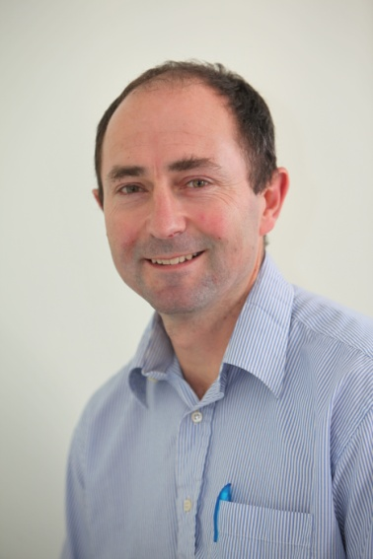
Anthony Rossiter
Department of Automatic Control and Systems Engineering
University of Sheffield
www.shef.ac.uk/acse
© 2014 University of Sheffield
This work is licensed under the Creative Commons Attribution 2.0 UK: England & Wales Licence. To view a copy of this licence, visit http://creativecommons.org/licenses/by/2.0/uk/ or send a letter to: Creative Commons, 171 Second Street, Suite 300, San Francisco, California 94105, USA.
It should be noted that some of the materials contained within this resource are subject to third party rights and any copyright notices must remain with these materials in the event of reuse or repurposing.
If there are third party images within the resource please do not remove or alter any of the copyright notices or website details shown below the image.
(Please list details of the third party rights contained within this work.
If you include your institutions logo on the cover please include reference to the fact that it is a trade mark and all copyright in that image is reserved.)

